Slide 1

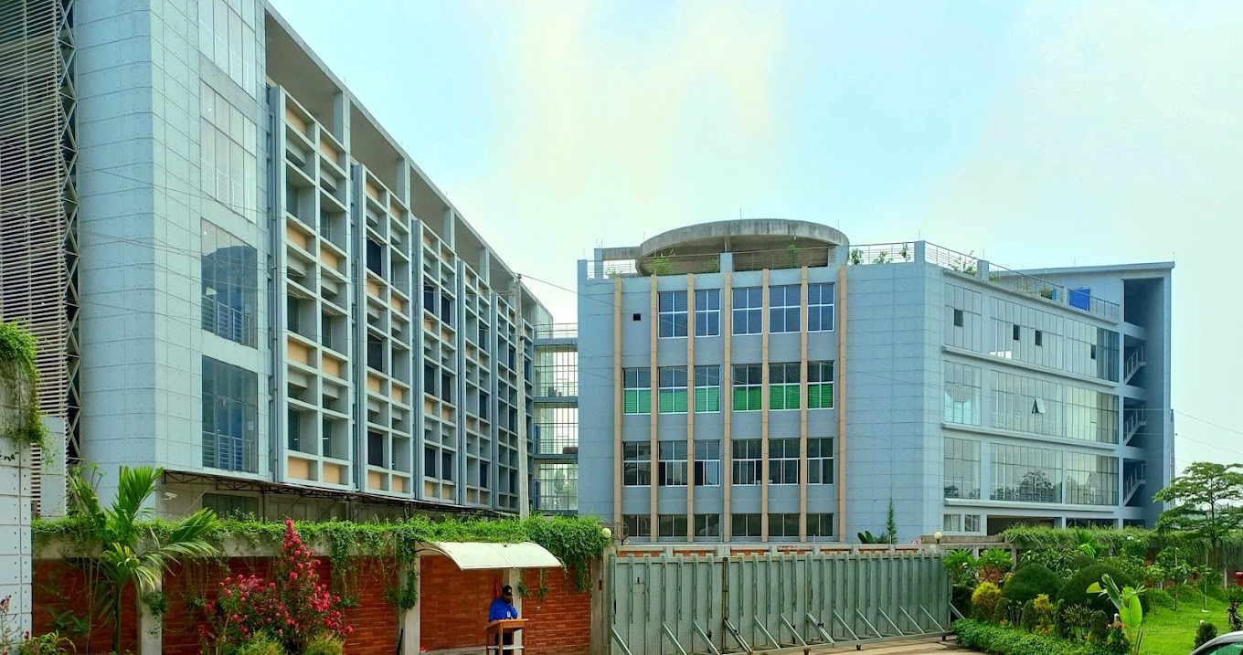












NORTHERN CORPORATION LTD.
Founded in the year 1987, We specialize in high-quality fashion wear manufacturing, delivering performance-driven apparel through advanced technology and expert craftsmanship.

Slide 2
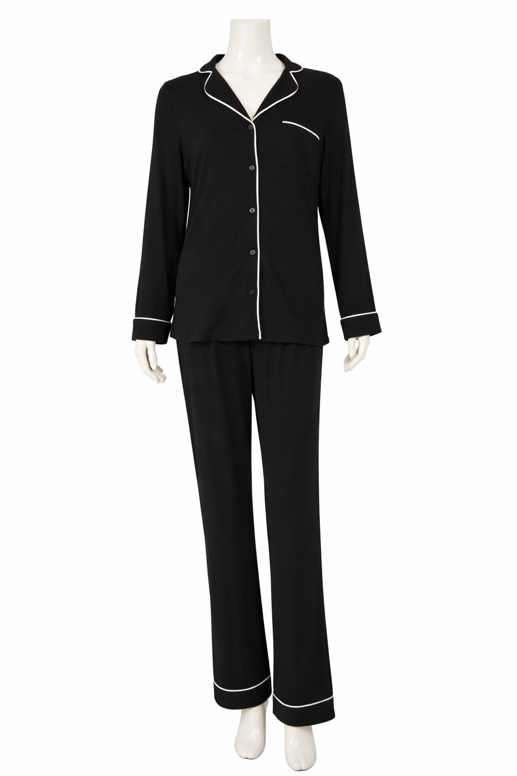
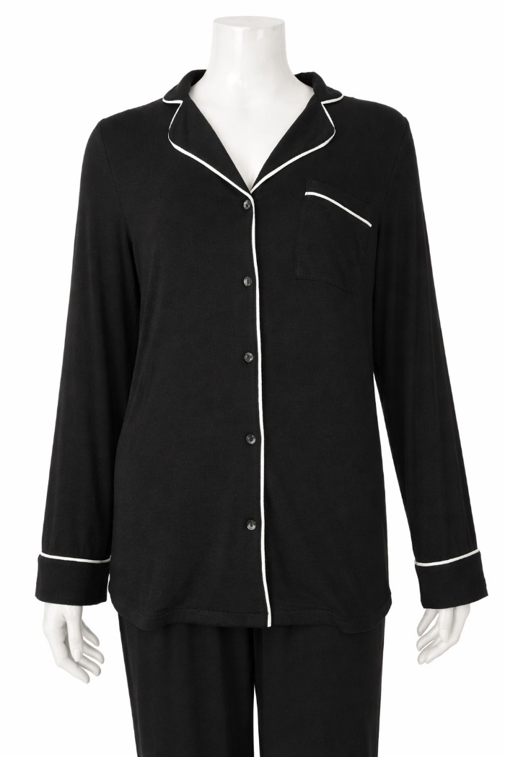

REF : NCL-10 Item : Ladies Top/Bottom set
Fabric : 100% cotton, S/J
Gsm : 170
BUYER: LINDEX
BRAND/LABEL: LINDEX

Slide 3
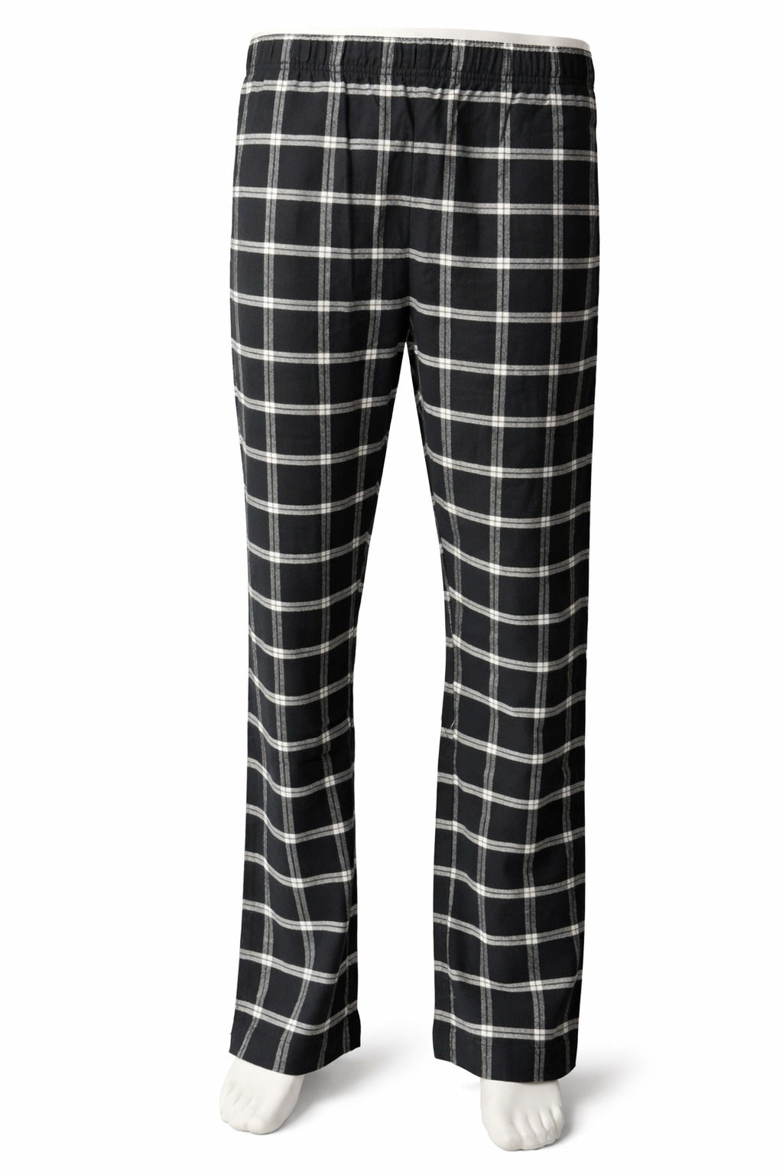
REF : NCL-01 STYLE : PIPYJSMAR1
Item : Mens Brushed Flannel Trousher
Fabric : 100% cotton, Flannel
Gsm : 170
BUYER: CELIO
BRAND/LABEL: CELIO

Slide 4
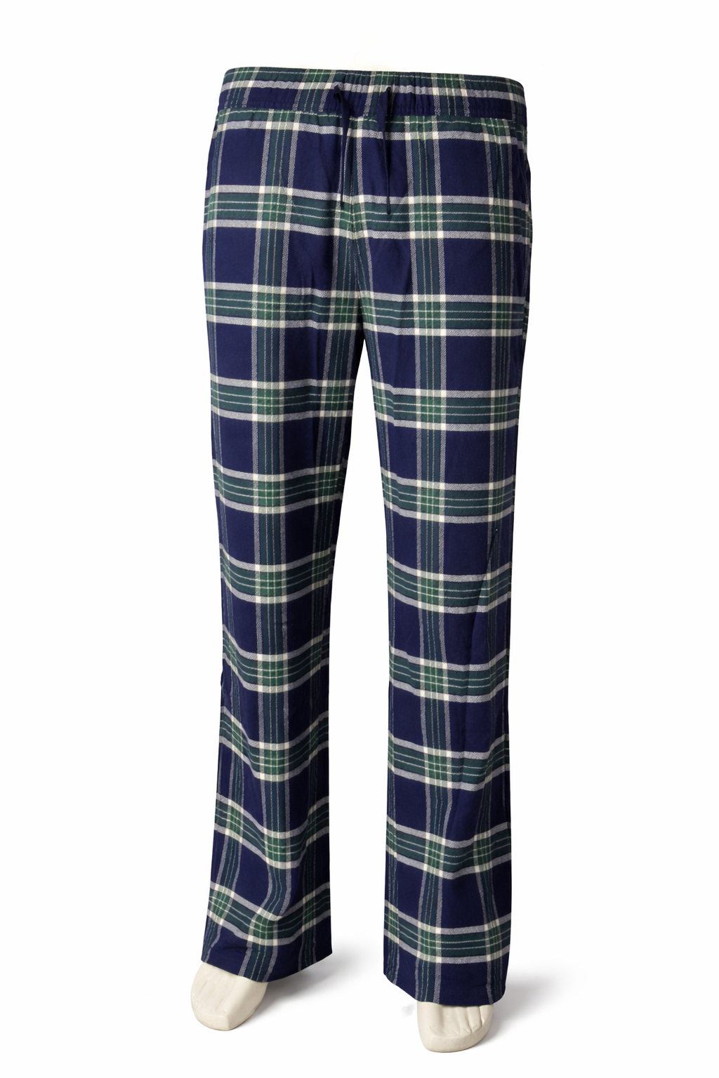
REF : NCL-02 STYLE : XPUPANTFLA
Item : Mens Brushed Flannel Trousher
Fabric : 100% cotton, Flannel
Gsm : 140
BUYER: CELIO
BRAND/LABEL: CELIO

Slide 5
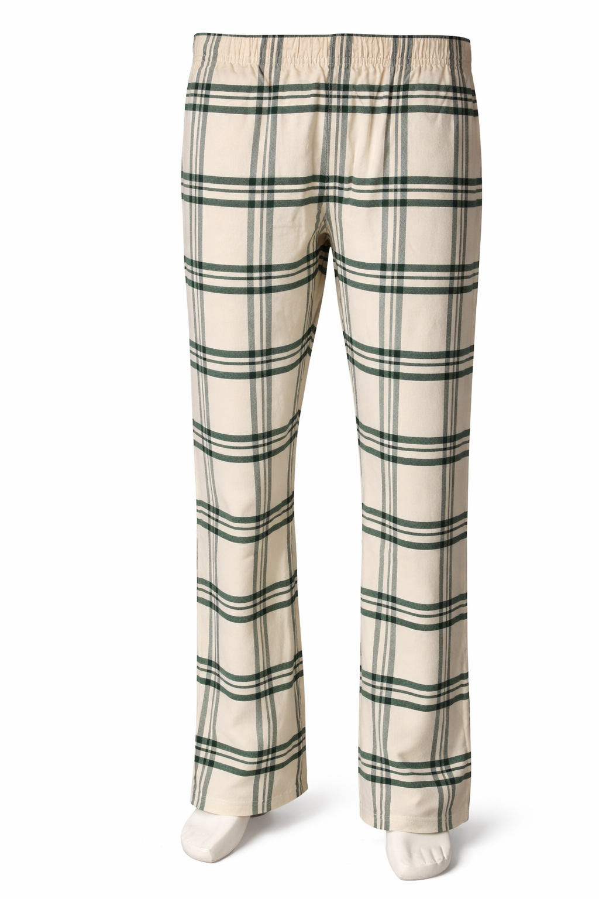
REF : NCL-03 STYLE : XPIPYRESTO
Item : Mens Brushed Flannel Trousher
Fabric : 100% cotton, Flannel
Gsm : 160
BUYER: CELIO
BRAND/LABEL: CELIO

Slide 6
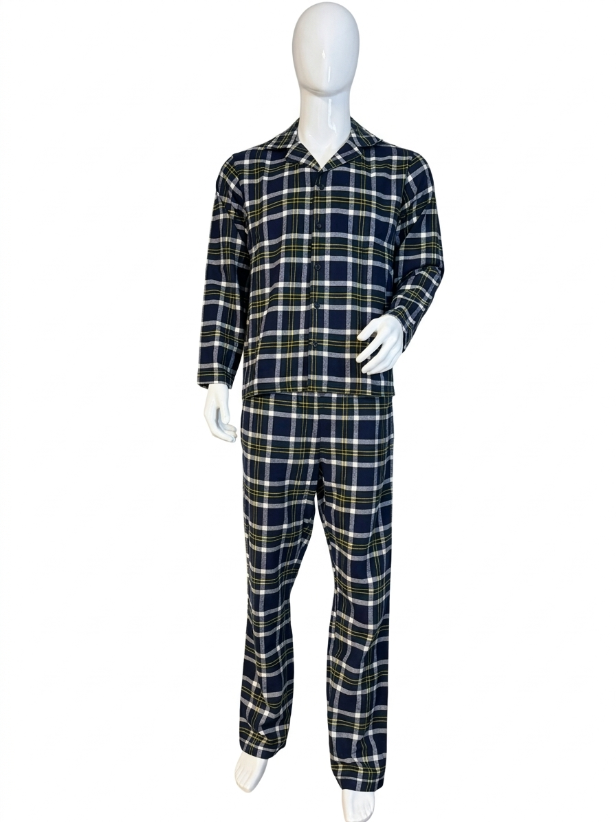
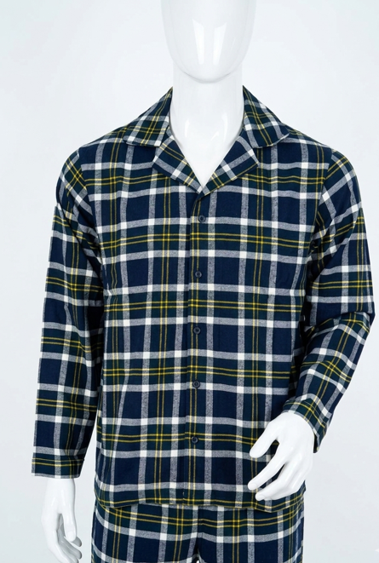
REF : NCL-04 STYLE : XPIPYTRAD
Item : Mens Top/Bottom set
Fabric : 100% cotton, BrushFlannel
Gsm : 160
BUYER: CELIO
BRAND/LABEL: CELIO

Slide 7
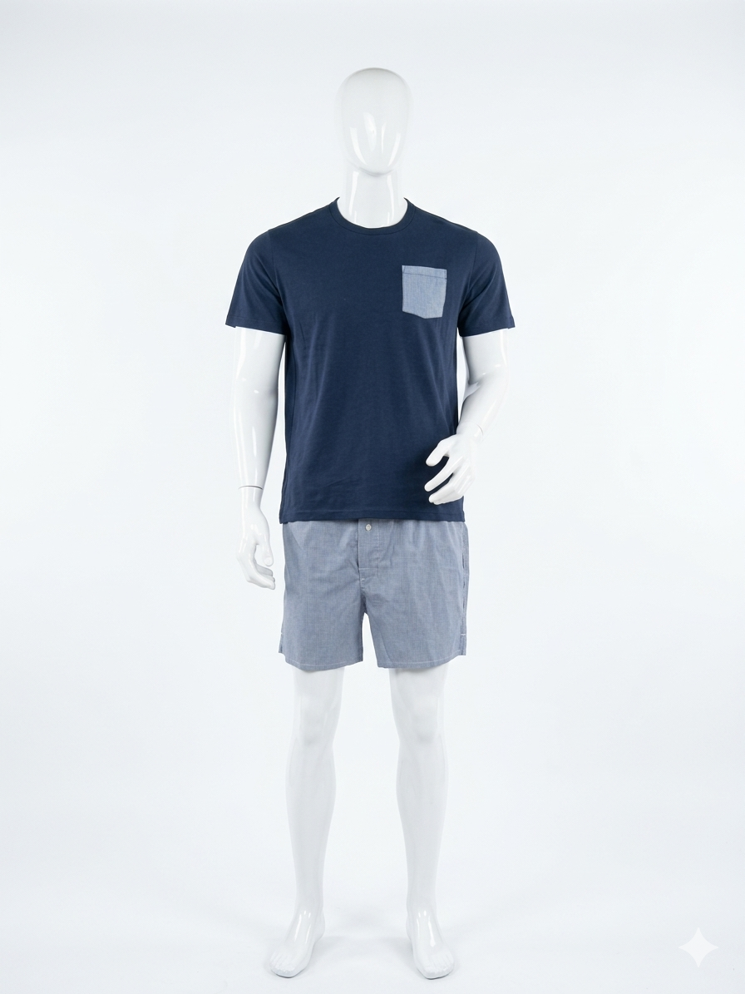
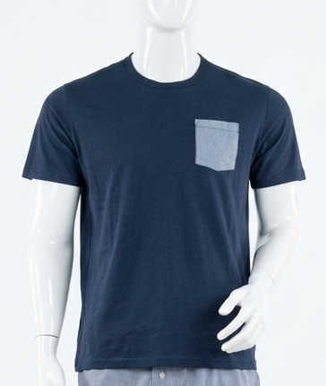
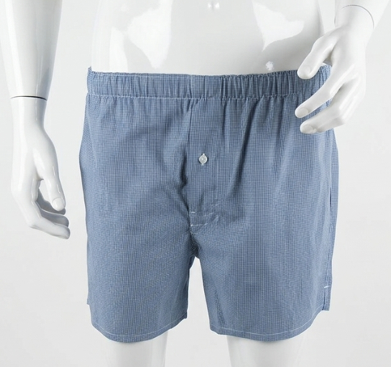
REF : NCL-05 (Set) STYLE : GIPYSHORT
Item : Mens Top/Bottom set
Fabric : 100% cotton
Gsm : 160
BUYER: CELIO
BRAND/LABEL: CELIO

Slide 8
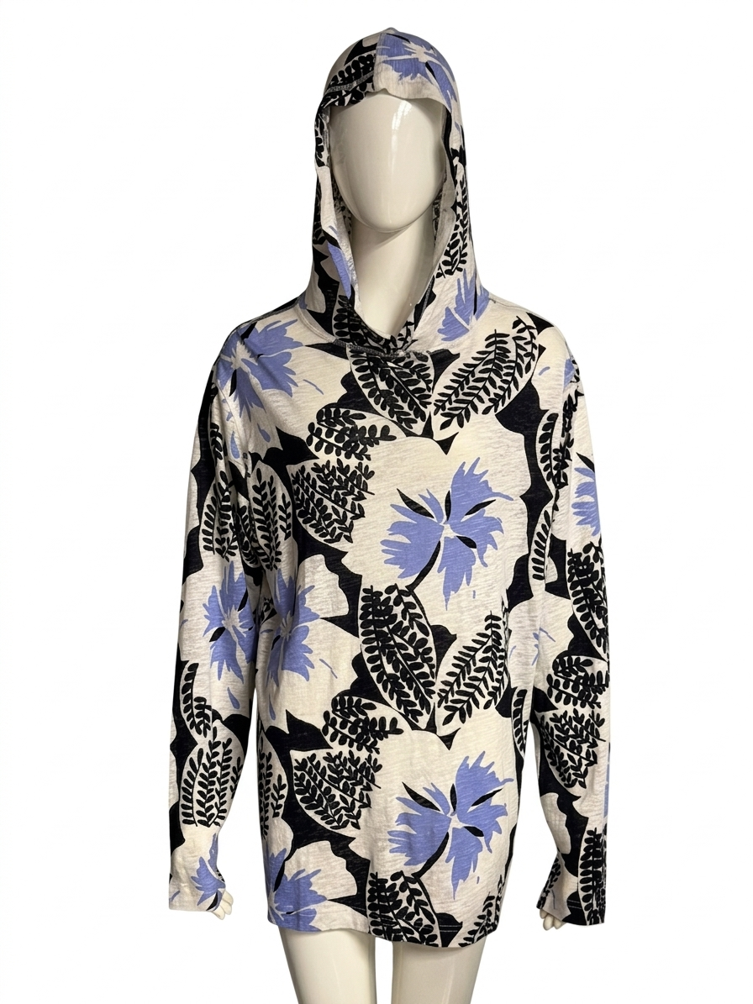
REF : NCL-06 STYLE : AN31592
Item : Ladies Hoodie
Fabric : 55% linen,45% loycell
Gsm : 170
BUYER:
BRAND/LABEL:

Slide 9
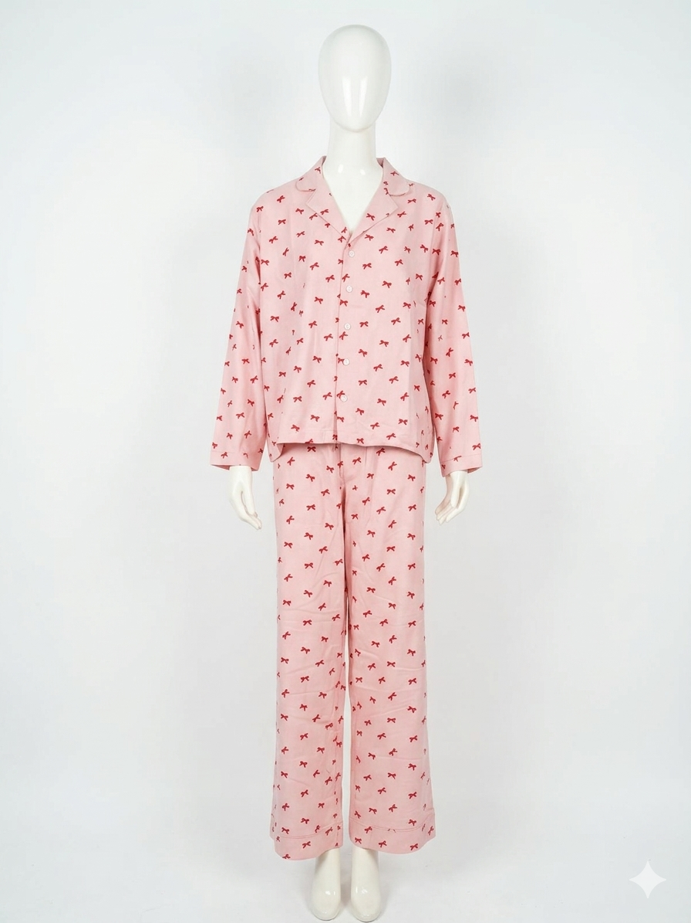
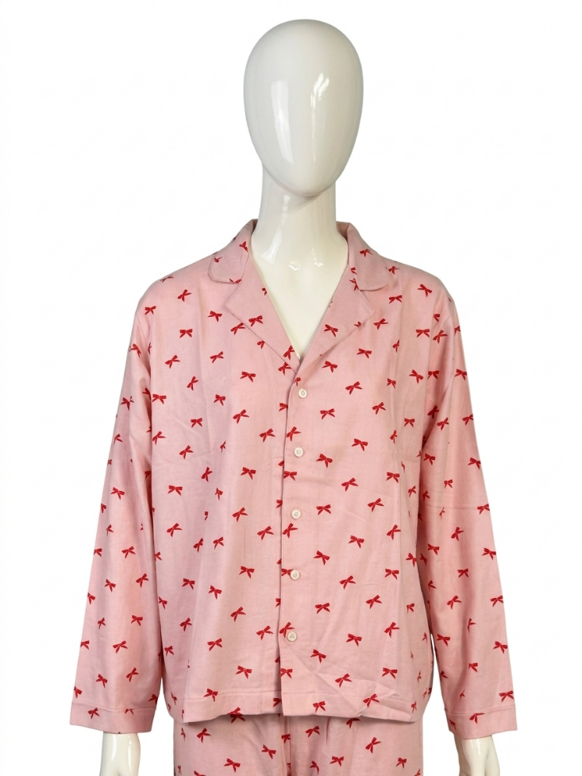
REF : NCL-07 STYLE : XPUPYJBOWS
Item : Ladies Top/Bottom Set
Fabric : 55% cotton, 45% viscose
Gsm : 150
BUYER: CELIO
BRAND/LABEL: CELIO

Slide 10
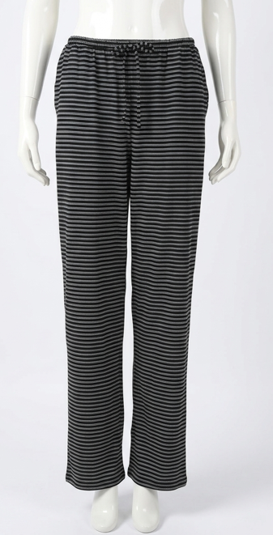
REF : NCL-08 STYLE : XPUPYJ
Item : Ladies Trouser
Fabric : 95% cotton, 5% spandex
Gsm : 180
BUYER: LINDEX
BRAND/LABEL: LINDEX

Slide 11
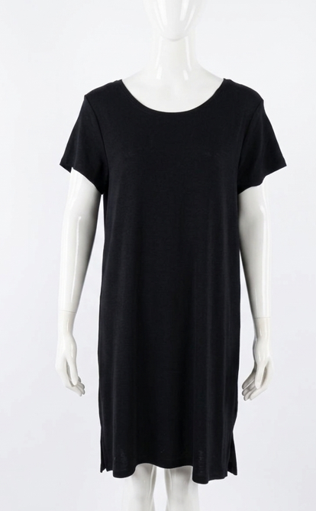
REF : NCL-09 Item : Ladies Top
Fabric : 100% cotton, S/J Merino wool
Gsm : 180
BUYER: LINDEX
BRAND/LABEL: LINDEX

Slide 12
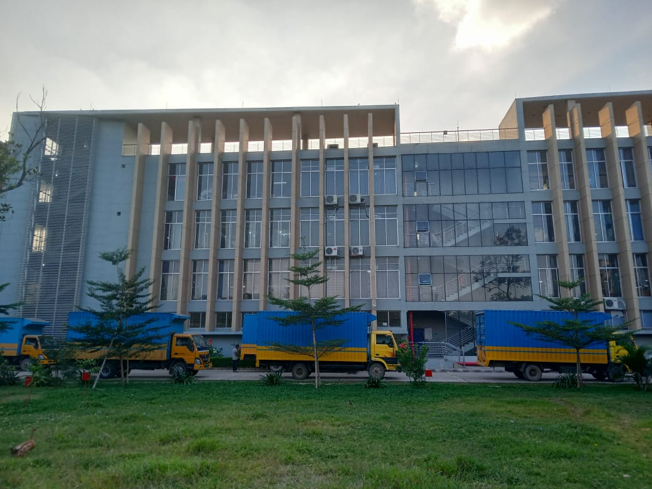
Contact Us :
Mr. Naim Hasan.
Managing Director.
Email: naim@ntg.net.bd
Mr. Rafiq Hasan.
Director.
Email: rafiq@ntg.net.bd
Mr. Abul Hasnat Mohammad Quamruzzaman, FCMA.
Executive Director.
Email: q.zaman@ntg.com.bd
THANK YOU!

